Slide 1
Data Team Training
Principals’ Meeting February 6, 2014
February 4, 7, 10, 2014

Slide 2
Learning Goal:
Participants will have a deeper understanding of Deliberate Practice as it relates to teacher improvement.
Participants will be able to complete their Administrative Reflection/Deliberate Practice section on PGS and assist teachers with questions and concerns.

Slide 3
Michael Jordan Video
http://www.youtube.com/watch?v=hXdj8scRdFE

Slide 4
Characteristics of Deliberate Practice
Subject’s Motivation
Study of Skill
Repeated performance
Immediate Informative Feedback

Slide 5
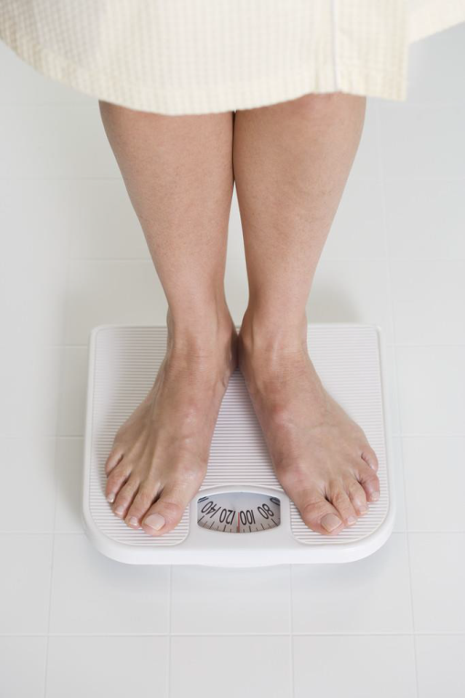
Motivation
Teacher invested
Teacher led
Teacher planned
Teacher measured
Teacher growth
Teacher success

Slide 6
Study of Skill
Instructional Framework Knowledge
•Study Previous Skill Experts
•PLC
•Mentoring
•Lesson Study
•Book Study

Slide 7
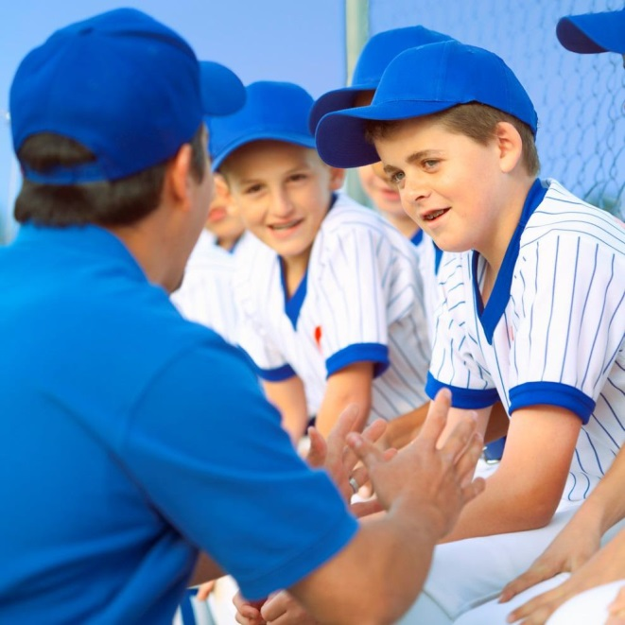
Immediate Informative Feedback
Information rich
Timely
Diagnostic
Formative
Growth Focused

Slide 8
Culture of Deliberate Practice What if…..
every teacher engaged in self-assessment of classroom practices?
every teacher focused on specific instructional strategies for growth?

Slide 9
Deliberate Practice Empowers Teachers
Repeated Performance, of focused practice, involves repeating a specific strategy with attention to improving detailed aspects of the strategy in order to reach a level of automaticity/fluency in use of the strategy.
Teachers can
Focus on specific steps of a strategy
Develop fluency with a strategy
Plan to monitor for the effect of the strategy
Prepare adaptations to a strategy
Create a macrostrategy incorporating the target strategy

Slide 10
Deliberate Practice
Deliberate Practice is an expectation that all teachers can increase their expertise from year to year which produces gains in student achievement from year to year with a powerful cumulative effect.

Slide 11
Phases in a Deliberate Practice Cycle (Annual Continuous Improvement Cycle)
1. Having a model of effective teaching
2. Setting growth goals
3. Engaging in focused practice
4. Receiving focused feedback
5. Observing and discussing teaching

Slide 12
Reflection/PGS
Go to PGS website, walk through the steps for completing section #5.
Provide an example.
www.santarosa.k12.fl.us

Slide 13
Deliberate Practice
More to Come Later!

Slide 14
https://www.teachingchannel.org/videos/high-school-band?utm_campaign=digest&utm_medium=email&utm_source=digest
https://www.teachingchannel.org/videos/when-lesson-plans-fail (mentor teachers high school)
https://www.teachingchannel.org/videos/evaluating-persuasive-speeches teacher reflection
https://www.teachingchannel.org/videos/student-goal-setting

